Slide 1
DFA
Office of Accounting
1099 Training
1

Slide 2
1099 Responsibilities
DFA
Office of Accounting
Each Agency is responsible for the accuracy of its own reportable vendor payments
DFA Office of Accounting is responsible for consolidating Agency reported vendor payment data and mailing, correcting, and filing 1099s with the IRS
TSS Office of State Procurement is responsible for Vendor maintenance & W9 verification.
2

Slide 3
W9 Decision Making Process
DFA
Office of Accounting
Vendor Needed
Yes
Display Vendor
AASIS Vendor Exists
No
W9 Needed from Vendor
No
Yes
Send W9 to OSP
Use One-Time Vendor
Vendor Master
Tax Code Correct
No
OSP Vendor Update
Yes
Continue Creating Invoice
3

Slide 4
Payment Tax Code Decision Making Process
DFA
Office of Accounting
Receive Invoice From Vendor
Display Vendor
Payment 1099
Reportable
Yes
Vendor 1099
Reportable
Yes
Master Tax
Code Correct
Yes
Create Payment Invoice
No
No
No
Payment Tax Code 00
Payment Tax Code 00
Vendor Change Request to OSP
Create Payment Invoice
4

Slide 5
Who is 1099 Reportable
DFA
Office of Accounting
Individuals
Sole Proprietors
Partnerships
Professional Associations
Corporations for Medical Payment and Attorney Fees ONLY (Tax Codes 06 & 10)
5

Slide 6
Who is NOT 1099 Reportable (00)
DFA
Office of Accounting
Corporations EXCEPT for Medical Payment and Attorney Fees ONLY (Tax Codes 06 & 10)
Government Entities
School Districts
Colleges & Universities
Foreign Vendors
Non-Profit Organizations
Employees (W9)
One-time Vendors
6

Slide 7
What is 1099 Reportable
DFA
Office of Accounting
Services
Services commingled with goods
Medical Payments
Prizes & Awards
Lawsuit Settlements
Attorney Fees
Rents and Leases of property paid directly to the landowner
7

Slide 8
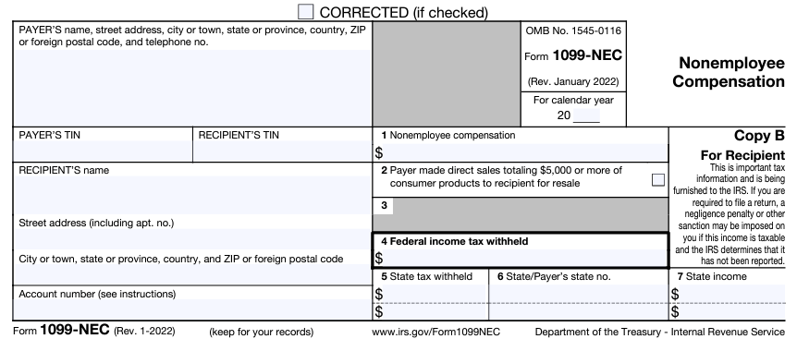
1099 Nonemployee Compensation (NEC)
DFA
Office of Accounting
1099 NEC - Box 1 – Nonemployee compensation
Payment Tax Code 07
Architect Fees
Attorney Fees
Board & Commission Member Stipends
Cleaning Services
Consultants
Daycare
Lawn Service
Maintenance & Repair where the part is incidental
https://www.irs.gov/forms-pubs/about-form-1099-nec
8

Slide 9
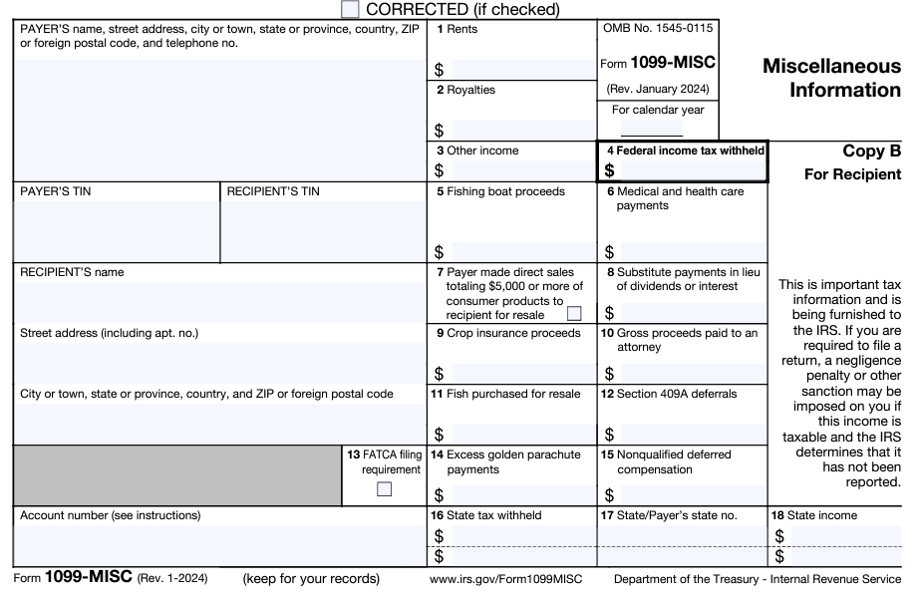
1099 Miscellaneous (MISC)
DFA
Office of Accounting
1099 MISC - Block 1 – Rents
Payment Tax Code 01
Includes rents and leases of property paid directly to the landowner
https://www.irs.gov/forms-pubs/about-form-1099-misc
9

Slide 10
1099 Miscellaneous (MISC)
DFA
Office of Accounting
1099 MISC - Block 3 – Other Income
Payment Tax Code 03
Prizes & Awards
Lawsuits paid to anyone OTHER than Attorneys
10

Slide 11
1099 Miscellaneous (MISC)
DFA
Office of Accounting
1099 MISC - Block 6 – Medical Payments
Payment Tax Code 06
Medical & Health Care services
Corporations are NOT EXEMPT
Pharmacies should NOT be included (You are buying goods, not services)
11

Slide 12
1099 Miscellaneous (MISC)
DFA
Office of Accounting
1099 MISC - Block 10 – Gross proceeds paid to an attorney
Payment Tax Code 10
An attorney receives monies on behalf of a client, usually from a lawsuit settlement or through a Benefit Vendor Payment in processing Payroll
It is unknown how much the client will receive and how much the attorney will retain
12

Slide 13
What is NOT 1099 Reportable
DFA
Office of Accounting
Goods or Goods/Services where the Services are incidental to the purchase
Reimbursement of Expenses
Rents and Leases paid to another other that the landowner
Loans and Advances that are required to be repaid
13

Slide 14
General 1099 Information
DFA
Office of Accounting
The IRS regulations require the State of Arkansas to report the aforementioned payments if the consolidated amount by Tax ID is $600 or greater
The State does not mail or report 1099s under this amount
14

Slide 15
General 1099 Information
DFA
Office of Accounting
The Office of Accounting is required to issue 1099s for the State Agencies that use the Statewide Tax ID 71-0847443 for its Vendor payments
The reportable vendors/payments made must be rolled up Statewide by the recipient vendor’s tax id or social security number.
There are vendors that are issued both EXEMPT (00) and Non-Exempt payments (06 & 10)
15

Slide 16
Fines & Penalties
DFA
Office of Accounting
The State of Arkansas is no longer exempt from IRS fines & penalties
IRS fines & penalties resulting from Agency errors will be charged to that Agency
16

